Slide 1
Time Series Analysis
Modeling Heteroskedasticity: Case Study
Nicoleta Serban, Ph.D.
Professor
Stewart School of Industrial and Systems Engineering
Exchange Rates Prediction: ARMA+GARCH Modeling

Slide 2

About This Lesson

Slide 3
ARIMA Model Fit
#Fit ARIMA on differenced series
final.aic=Inf; final.order=c(0,0,0)
for (p in 1:10) for (d in 0:1) for (q in 1:10){
current.aic=AIC(arima(diff.rate,order=c(p, d, q)))
if(current.aic<final.aic){
final.aic=current.aic; final.order=c(p,d,q)
final.arima=arima(diff.rate, order=final.order)} }
acf(squared.resids,main='ACF Squared Residuals of USD/EUR ARIMA Fit')
Selected Orders EUR: AR=8, MA=7
BRL: AR=9, MA=9
CYN: AR=1, MA=1
Due to discontinuities in the time series

Slide 4
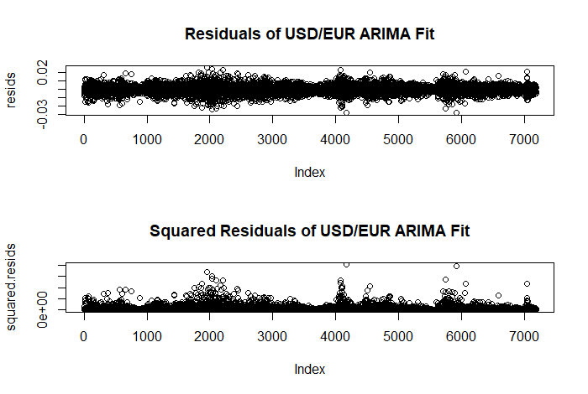
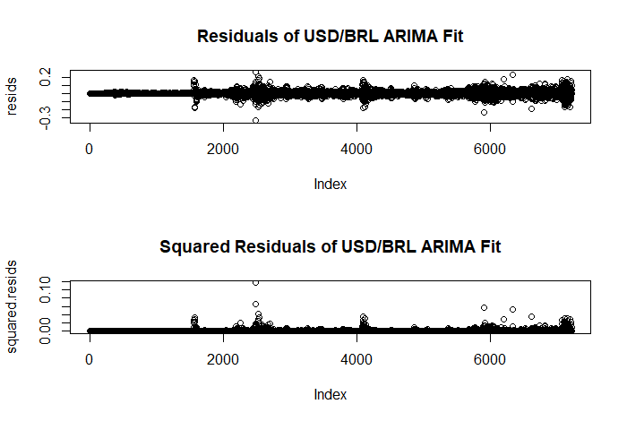
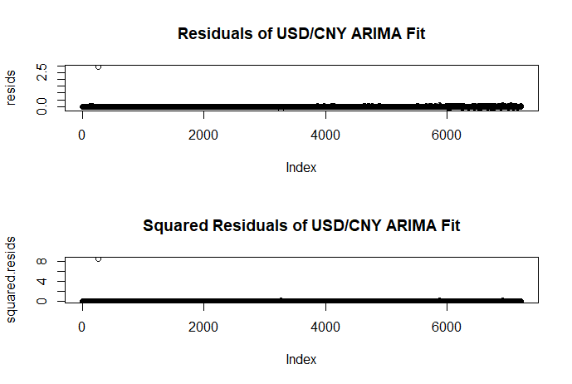
ARIMA Model Fit: Residual Analysis

Slide 5
ARIMA Fit: Residual Analysis (cont’d)
> #test for serial correlation
Box-Ljung test
data: resids
X-squared = 8.5465, df = 1,
p-value = 0.003462
> #test for arch effect
Box-Ljung test
data: (resids)^2
X-squared = 1704.7, df = 1,
p-value < 2.2e-16
> #test for serial correlation
Box-Ljung test
data: resids
X-squared = 40.747, df = 1, p-value = 1.732e-10
> #test for arch effect
Box-Ljung test
data: (resids)^2
X-squared = 5621.2, df = 1, p-value < 2.2e-16
> #test for serial correlation
Box-Ljung test
data: resids
X-squared = 0.15214, df = 1, p-value = 0.6965
> #test for arch effect
Box-Ljung test
data: (resids)^2
X-squared = 0.00046319, df = 1, p-value = 0.9828
USD/EUR
USD/BRL
USD/CNY

Slide 6
GARCH Order Selection
#GARCH Order Selection
library(rugarch)
#Select model with smallest BIC
final.bic = Inf
final.order = c(0,0)
for (m in 0:3) for (n in 0:3){
spec = ugarchspec(variance.model=list(garchOrder=c(m,n)),
mean.model=list(armaOrder=c(8, 7), include.mean=T),
distribution.model="std")
fit = ugarchfit(spec, data.train, solver = 'hybrid')
current.bic = infocriteria(fit)[2]
if (current.bic < final.bic){
final.bic = current.bic
final.order = c(m, n)
}}
USD/EUR case
Selected Orders for modeling the conditional variance:
m=1, n=1

Slide 7
ARMA Order Selection (refined)
#Refine the ARMA order
final.bic = Inf
final.order.arma = c(0,0)
for (p in 0:6) for (q in 0:6){
spec = ugarchspec(variance.model=list(garchOrder=c(1,1)),
mean.model=list(armaOrder=c(p, q), include.mean=T),
distribution.model="std")
fit = ugarchfit(spec, data.train, solver = 'hybrid')
current.bic = infocriteria(fit)[2]
if (current.bic < final.bic){
final.bic = current.bic
final.order.arma = c(p, q)
}
}
USD/EUR case
Selected Orders for modeling the conditional mean:
AR=2, MA=1

Slide 8
GARCH Order Selection (refined)
#Refine the GARCH order
final.bic = Inf
final.order.garch = c(0,0)
for (m in 0:3) for (n in 0:3){
spec = ugarchspec(variance.model=list(garchOrder=c(m,n)),
mean.model=list(armaOrder=c(final.order.arma[1], final.order.arma[2]),
include.mean=T), distribution.model="std")
fit = ugarchfit(spec, data.train, solver = 'hybrid')
current.bic = infocriteria(fit)[2]
if (current.bic < final.bic){
final.bic = current.bic
final.order.garch = c(m, n)
}
}
USD/EUR case
Selected Orders for modeling the conditional variance:
m=1, n=1

Slide 9
Order Selection: Comparison
ARMA(8,7)+GARCH(1,1)
ARMA(2,1)+GARCH(1,1)
ARMA(2,1)+GARCH(1,1)
USD/EUR currency
ARMA(9,9)+GARCH(2,3)
ARMA(2,3)+GARCH(2,3)
ARMA(2,3)+GARCH(2,3)
USD/BRL currency
ARMA(1,1)+GARCH(3,2)
ARMA(1,0)+GARCH(3,2)
ARMA(1,0)+GARCH(3,2)
USD/CYN currency

Slide 10
Order Selection: Full vs Reduced Time Series
ARMA(1,1)+GARCH(3,2)
ARMA(1,0)+GARCH(3,2)
ARMA(1,0)+GARCH(3,2)
USD/CYN currency:
Full Data (1993-2020)
ARMA(8,10)+GARCH(1,3)
ARMA(0,1)+GARCH(1,3)
ARMA(0,1)+GARCH(3,3)
USD/CYN currency:
Reduced Data (2000+2020)

Slide 11
ARMA+GARCH: Model Evaluation
USD/EUR
USD/BRL
USD/CNY
> infocriteria(final.model.1)
Akaike -7.922252
Bayes -7.903061
Shibata -7.922268
Hannan-Quinn -7.915647
> infocriteria(final.model.2)
Akaike -7.920894
Bayes -7.913217
Shibata -7.920896
Hannan-Quinn -7.918252
> infocriteria(final.model.1)
Akaike -6.050131
Bayes -6.025183
Shibata -6.050158
Hannan-Quinn -6.041545
> infocriteria(final.model.2)
Akaike -6.016480
Bayes -6.004005
Shibata -6.016486
Hannan-Quinn -6.012186
> infocriteria(final.model.1)
Akaike -10.02104
Bayes -10.00377
Shibata -10.02106
Hannan-Quinn -10.01510
> infocriteria(final.model.2)
Akaike -10.31563
Bayes -10.30699
Shibata -10.31563
Hannan-Quinn -10.31266
Both models perform similarly: choose least complex model

Slide 12

Summary

